Slide 2
IPv6 Testing for End Users Experience, Results, Outlook,…
Primož Dražumerič

Slide 3
Telekom Slovenije IPv6 fixed network facts
TS IP/MPLS network has been fully IPv6 capable since 2010
Most of our portals have been Dual-Stack enabled since 2010
BRAS-es inside TS network have been fully IPv6 capable since 2013
TS has been offering IPv6 services for business customers since 2011
TS started offering IPv6 services for residential customers in 2014

Slide 4
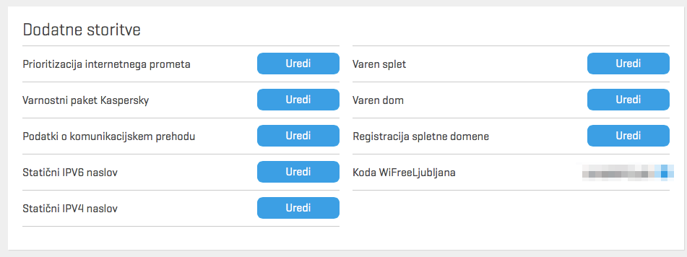
IPv6 technical solutions
A decision was made to support IPv6 services as dual-stack on all services
IPv6 service can be enabled via customer care portal
https://moj.telekom.si

Slide 5
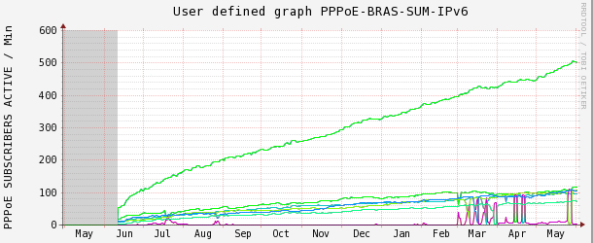
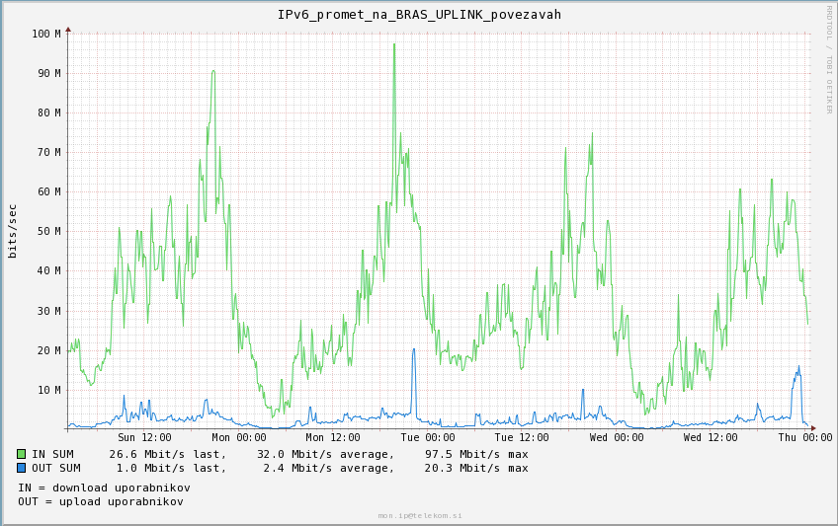
Telekom Slovenije IPv6 in numbers
In the last year over 600 customers decided to activate Dual-Stack Ipv6 services in the residential network
Over 100 business customers were connected over IPv6 connections.
Residential Dual-Stack customers are currently generating around 100Mbps of traffic in peak

Slide 6
Telekom Slovenije plans
In July TS expects to offer all our new customers Dual-Stack enabled by default at the time of service activation.
TS engineers are working hard with CPE vendors to enable IPv6 support on as many CPE‘s as possible by the hardware capabilities

Slide 7
Problems with IPv6 network implementation
We did not encounter any major problems while offering Dual Stack services.

